Slide 1
Flexible Benefits Program 2022 Open Enrollment Presentation for Plan Year 2023
Human Resources Administration
October 11, 2022

Slide 2
Flexible Benefits Topics
Human Resources Administration (HRA) Flexible Benefits Team
Open Enrollment Period
2023 Flexible Benefits Program Enhancements and Changes
2023 Flexible Benefits Vendors
2023 Flexible Benefits Plan Options
Flexible Benefits Virtual Benefits Fair
GaBreeze Enrollment Portal
Open Enrollment (OE) Reminders
Open Enrollment (OE) Helpful Hints
Open Enrollment (OE) Report
Resources

Slide 3

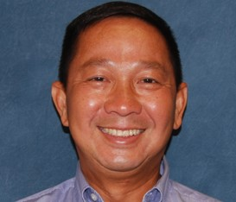


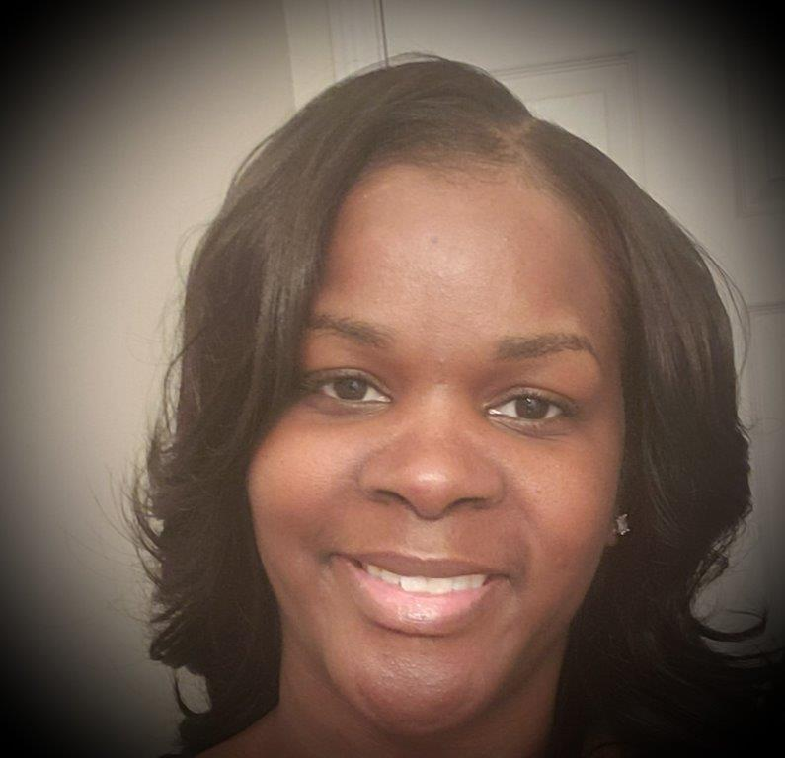

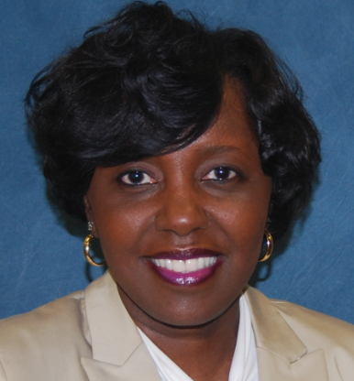
HRA Flexible Benefits Team
Son Truong
Benefits Specialist
Marcie Akins
Benefits Specialist
Carla Gracen
Director
Monica Laws-Smith
Benefits Specialist
Barbara Heard
Benefits Analyst
Leneequa Morris
Benefits Manager

Slide 4

2022 Open Enrollment (OE) for 2023 Plan Year
Begins October 17, 2022 at 1:00 a.m. ET
Ends November 5, 2022 at 12:59 a.m. ET
During OE, eligible active employees may:
Enroll in Flexible Benefits coverage
Change Plan Option and/or Vendor
Enroll eligible dependents
Drop covered dependents
Increase or Decrease coverage tier
Discontinue Flexible Benefits plan option(s)

Slide 5
2023 Flexible Benefits Program Enhancements and Changes
Effective January 1, 2023:
Cigna Dental will be the new vendor for the Dental PPO plan options
A new dental mid option, Select Mid, was added
Calendar year maximum increased on the Dental Select plan option (from $500 to $750)
Orthodontia lifetime maximum will start over in 2023
Implant benefits are available under the Dental Select Mid and Select Plus plan options
Premiums were reduced on the Dental and Vision Select and Select Plus plan options
Cigna DHMO and MetLife Legal added additional services and/or enhancements with no premium increase
The Health Care Flexible Spending Account limit increased to $2,808
Unum’s Long-Term Care premiums will increase by 15% on plan options with Compound Inflation
Important Notes: If you are currently enrolled in any Flexible Benefits plan options, all options excluding the Flexible Spending Accounts (Health and/or Dependent Care) will automatically roll over to the 2023 Plan year. Flexible Spending Accounts do not automatically roll over. If you want to continue your FSA(s) contributions for the 2023 plan year, you must re-enroll during this OE period.

Slide 6








2023 Flexible Benefits Vendors
Dental HMO & Dental PPO
Vision
Alight
Life & Accidental Death & Dismemberment, Legal Plans
Eligibility and Enrollment
Flexible Spending Accounts
Short-Term & Long-Term Disability
Long-Term Care
Critical Illness & Accident

Slide 7
Flexible Benefits Plan Options
Dental PPO & DHMO
Vision
Employee Life
Spouse Life
Child Life
Accidental Death & Dismemberment (AD&D)
Health Care Flexible Spending Account (HCFSA)
Dependent Care Flexible Spending Account (DCFSA)
Short-Term Disability (STD)
Long-Term Disability (LTD)
Long-Term Care (LTC)
Employee and Spouse Critical Illness
Employee and Spouse Critical Illness (Accident)
Legal Plans

Slide 8


Dental – Cigna DHMO
Cigna’s DHMO Plan – Required to use in-network providers only
Coverage area is limited to where network providers are located
Participants must live or work in the covered service area – Check the list of providers
There is no waiting period for any covered services and no annual maximum benefits
Note: See the 2023 Patient Charge Schedule (PCS) for covered services and your copayments.

Slide 9

Dental - Cigna PPO
Three plan options:
  Select
  Select Mid
  Select Plus
Option to use in-network and/or out-of-network providers
Note: Dental implant benefits and orthodontia coverage are available under the Select Mid and Select Plus plan options
9

Slide 10

Vision Access Value – Anthem Blue Cross Blue Shield (Anthem)
Select Plan
Eye exam and eyeglass lenses every year, copayments apply
$130 allowance for frames every two years
Prescription contact lenses – To receive the full $105 allowance, you must receive your exam, fitting and evaluation at a single visit to the same network provider
Select Plus Plan
Eye exam and eyeglass lenses every year, copayments apply
$150 allowance for frames every year
Prescription contact lenses – To receive the full $150 allowance, you must receive your exam, fitting and evaluation at a single visit to the same network provider

Slide 11


MetLife Insurance
Plan Options Include:
Employee Life
Spouse Life
Child Life
Accidental Death & Dismemberment
Plan Features Include:
Employees may elect up to ten times pay to a maximum benefit of $2,000,000
Evidence of Insurability is medical underwriting that is required if you apply for an amount of insurance in excess of (1) times your pay, or $200,000
New Hires are guaranteed up to $30,000 in spouse coverage without Evidence of Insurability

Slide 12

Health Care & Dependent Care Flexible Spending Accounts (FSAs)- WageWorks
Pre-tax dollars for medical or daycare expenses
Dependent Care for children under 13 years of age or other eligible dependent as defined by the IRS
Note: FSA contributions do not rollover. If you want to continue your FSA(s) contributions for the 2023 plan year, you must re-enroll during this OE period.

Slide 13
Short-Term Disability & Long-Term Disability - The Standard
Short-Term Disability
Benefit Waiting Periods
  Option A – 7 Days
  Option B – 30 Days
Note: Benefits are not payable during the 7 or 30-day waiting period.
Long-Term Disability
Benefit Waiting Period
  180 days

Slide 14


Long-Term Care - Unum
Provides a wide range of personal care, health, and social services for people of all ages who suffer a chronic disease or long-lasting disability.
These services can be provided in a nursing facility, an adult day care center, or at home, and can involve some nursing care.
Coverage is available to you, your spouse, your parents and/or your parents-in-law.

Slide 15


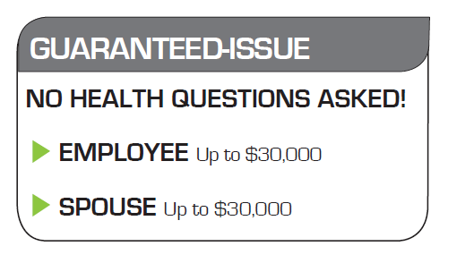
Employee & Spouse Critical Illness and Critical Illness Plus (Accident) - AFLAC/CAIC
Lump Sum Benefits payable upon initial diagnosis of a covered critical illness.
Each Dependent Child is covered at 50% of the primary insured amount at no additional charge.
Continental American Insurance Company

Slide 16

Legal - MetLife Legal Plans, Inc.
Three Plan Options:
  Select
  Select Plus
  Select Premium
Employees and family members have access to an attorney, as if on retainer, through MetLife’s nationwide network of more than 18,000 pre-qualified attorneys

Slide 17
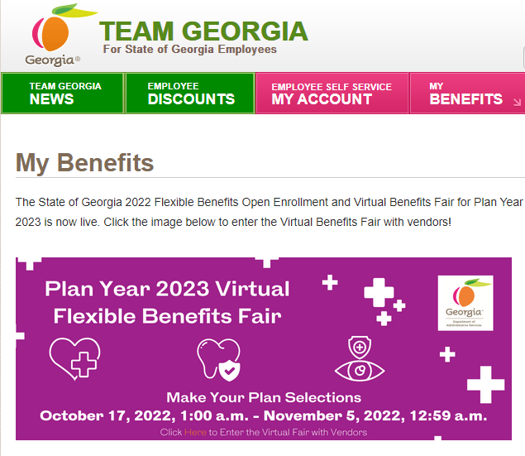
Flexible Benefits Virtual Benefits Fair
Virtual Benefits Fair Website
www.team.ga.gov
https://team.georgia.gov/benefits-expo-open-enrollment/
https://team.georgia.gov/plan-year-2023-flexible-benefits-vendors/

Slide 18
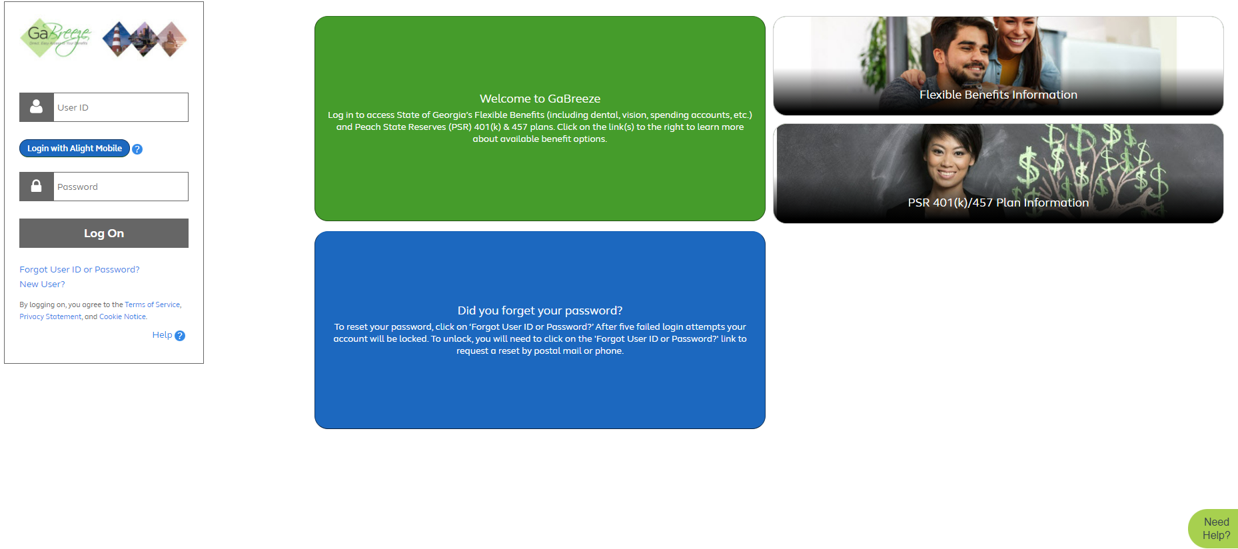
GaBreeze – Enrollment Portal
GaBreeze Benefits Center
1-877-342-7339 toll-free
Monday - Friday, 8:00 a.m. – 5:00 p.m. ET
www.GaBreeze.ga.gov

Slide 19



Open Enrollment (OE) Reminders
Employees are encouraged to confirm their access to the enrollment portal in advance of Open Enrollment which starts on October 17, 2022 at 1:00 a.m. ET and ends on November 5, 2022 at 12:59 a.m. ET
www.GaBreeze.ga.gov
Employees should review and/or update their email addresses and select their email preferences (personal or work) on GaBreeze
  Update email address in the “Personal Information” section of the “ Your Profile” page
19

Slide 20

Open Enrollment (OE) Reminders cont’d
Employees will receive a confirmation number upon successfully completing their OE elections.
Note: You must select the “Complete Enrollment” button once you’ve completed your elections.
Additional changes will be permitted online during the during the Open Enrollment period of October 17, 2022 through November 5, 2022.
  Employees will retain the same confirmation number.
  Date/time stamp will update to reflect the most recent completion.
  The last change will lock in the employees’ flexible benefits election for 2023 Plan Year.

Slide 21

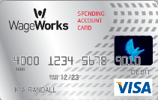
Open Enrollment (OE) Reminders cont’d
Flexible Spending Accounts (FSAs)
Employees must re-enroll in the Health Care Flexible Spending Account (HCFSA) and Dependent Care Flexible Spending Account (DCFSA) during Open Enrollment. FSAs do not roll over
https://myspendingaccount.wageworks.com/ is the 1st stop for research, employee inquiries, and to check HCFSA and DCFSA balances

Slide 22




Open Enrollment (OE) Reminders cont’d
Remind employees to review, designate and/or update their beneficiaries during Open Enrollment and throughout the year, if they experience any of these qualifying life events (QLEs).
  Marriage
  Divorce
  Death in the family
  Changes in dependents

Slide 23

Open Enrollment Helpful Hints
New Hires/Rehires During Open Enrollment
Employees hired by November 1, 2022 will have 2 enrollments:
  PY 2022: Current Plan Year for benefits effective December 1st
  PY 2023: New Plan Year for benefits effective January 1st
Flexible Benefits will roll over for New Hires/Rehires who make elections for the PY 2022 and do not make elections for PY 2023 during Open Enrollment.
    Exception: Flexible Spending Accounts do not roll over.

Slide 24

Open Enrollment (OE) Reports
FLX Pending Enrollment Status Report on the Employer website will provide a snapshot of employees who have not made their benefit elections during Open Enrollment.
  New hires and/or current employees who have not completed OE
  Report will be produced daily during the OE period
FLX Annual Benefit Deduction Report provides a list of all employee flexible benefit deductions for the new Plan Year.
FLX Annual Imputed Income Report provides all Employee Life Insurance elections for the new Plan Year.

Slide 25


Resources for Employees/Participants
Link to GA Breeze is located on the Flexible Benefits tab
www.Team.Ga.gov
www.GA Breeze.ga.gov
GA Breeze Benefits Center
1-877-342-7339 (Toll-Free)
Monday-Friday, 8:00a.m. - 5:00p.m. ET
(excluding holidays)
Websites
https://team.georgia.gov/benefits-expo-open-enrollment/
https://team.georgia.gov/plan-year-2023-flexible-benefits-vendors/

Slide 26


HRA.FlexBenefits@doas.ga.gov
Please email us if you have any questions or need assistance with Flexible Benefits.
WE ARE HERE TO HELP!!
26

Slide 27

Questions

Slide 28

Thank you!
http://team.georgia.gov/my-benefits/

